Slide 1
EE 542 Lab 8
Charlie Andre, Sufyan Shaikh

Slide 2
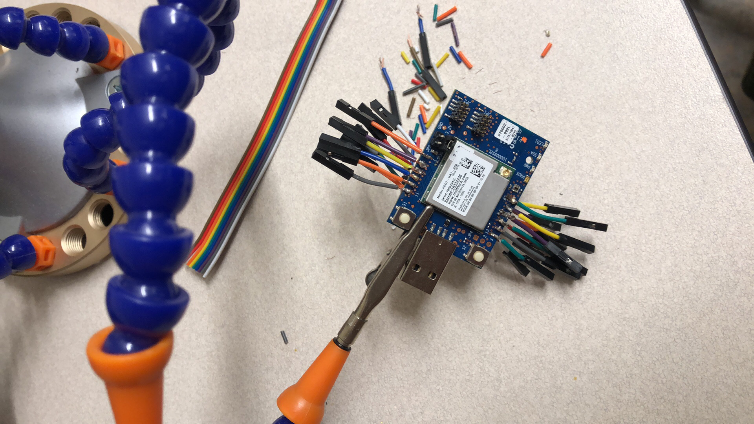
Getting started
Plug the XDOT into the USB port on your laptop
Solder on some connections to your XDOT so that you can connect I/O to it
Ours looks like this to make prototyping quicker and easier:

Slide 3

Go to mbde.com, create an account, go to XDOT page

Slide 4
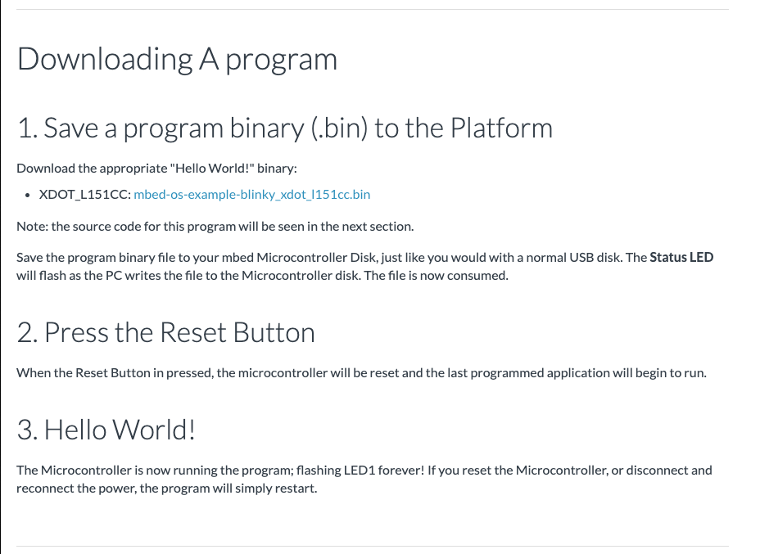
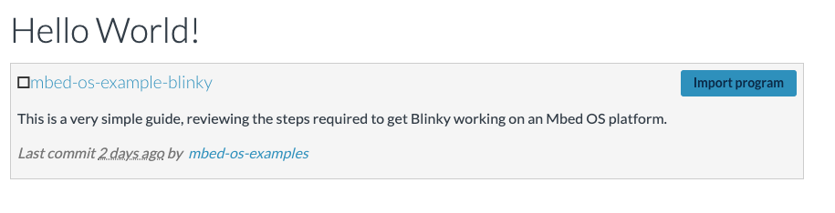
Import the blinky program

Slide 5
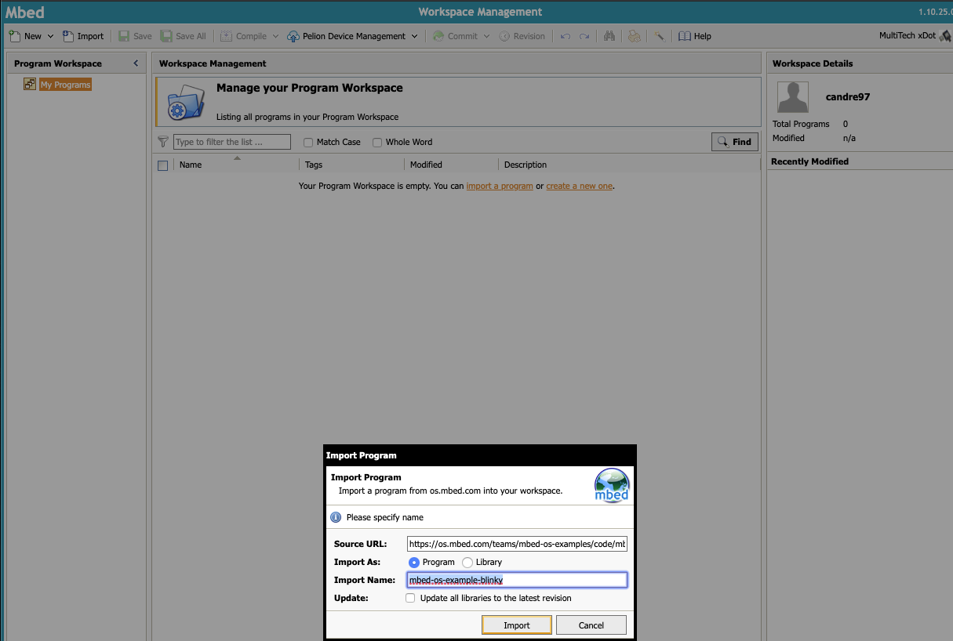

Slide 6
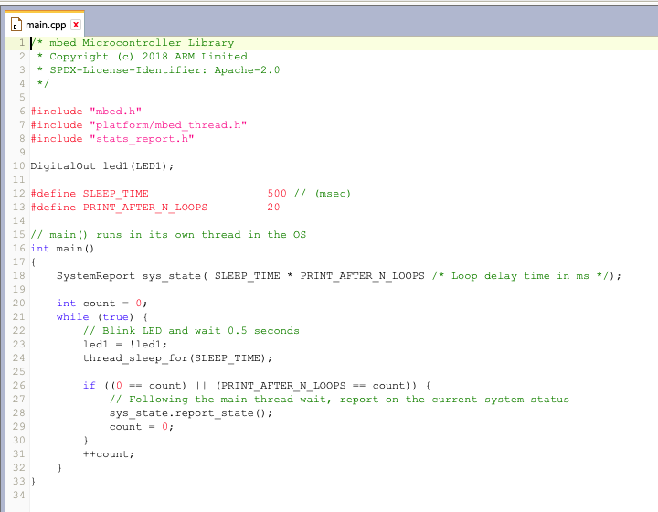

Slide 7
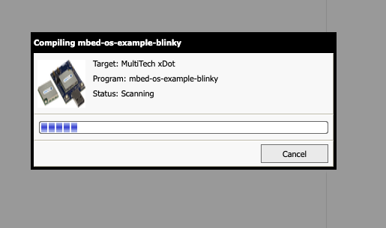
Compile the code

Slide 8
Check the name of the USB connection (Mac)

Slide 9
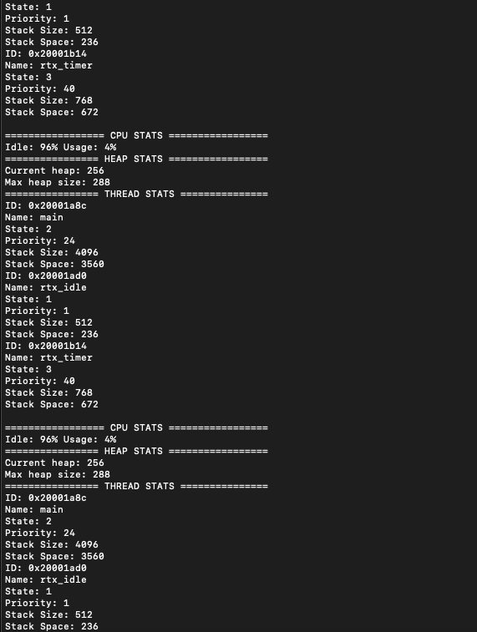
Connect using cu, check out terminal output
sudo cu -l /dev/tty.usbmodem1444202

Slide 10
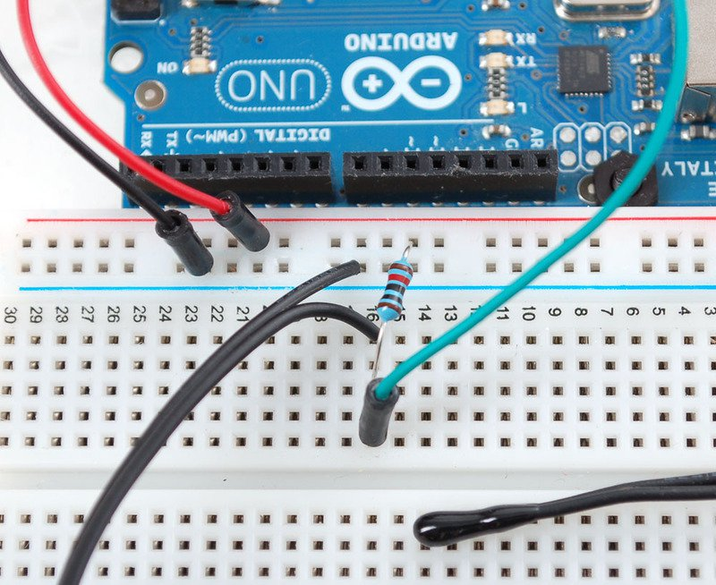
Set up the thermistor circuit according to the adafruit tutorial

Slide 11
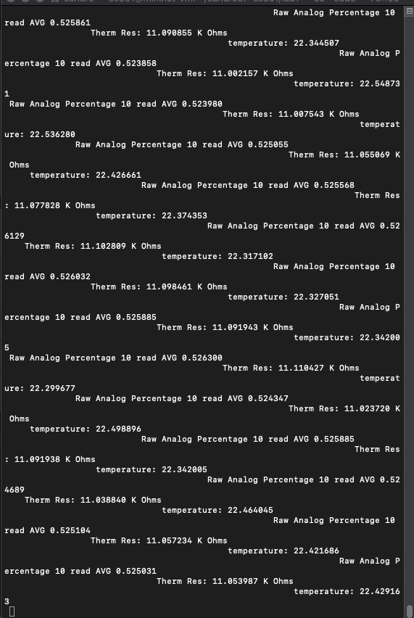
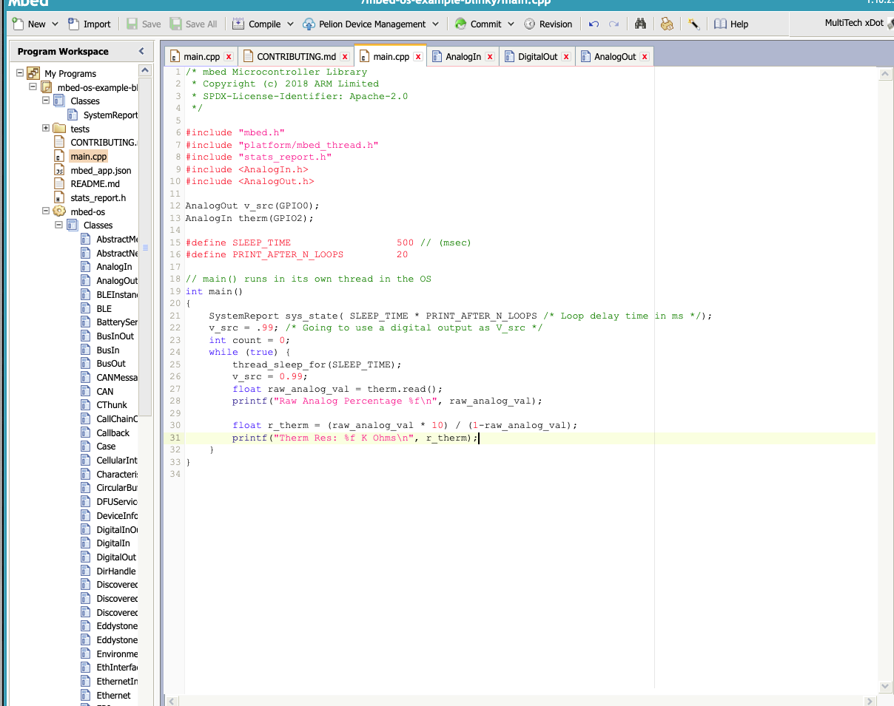
Write up some really basic thermistor code to test Analog in functionality

Slide 12
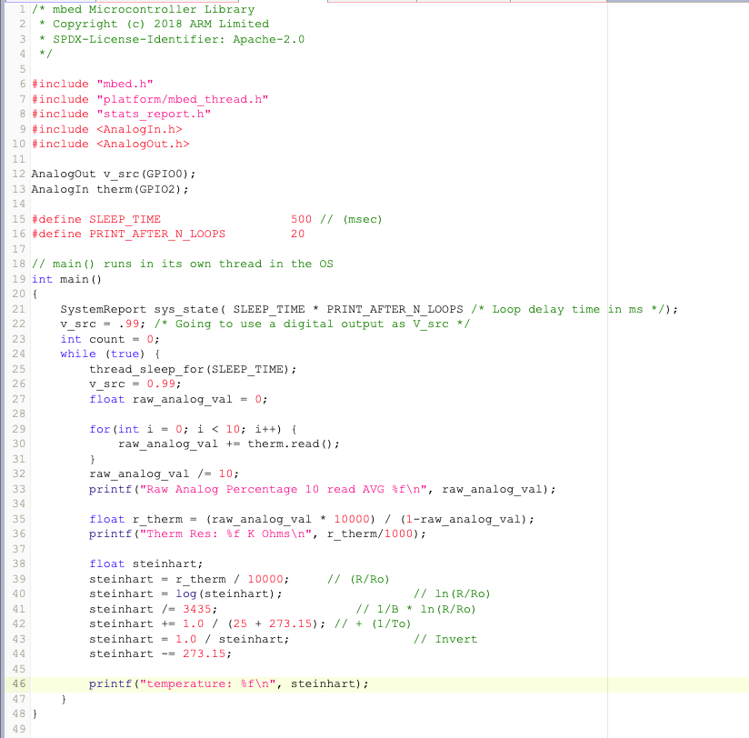
Use the analog input to calculate temperature

Slide 13
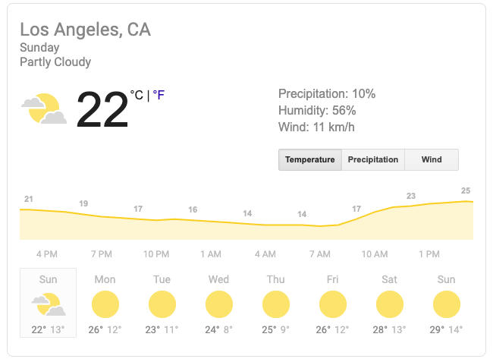
Connect to the XDOT
The temperature is really close to the
actual temperature right now

Slide 14
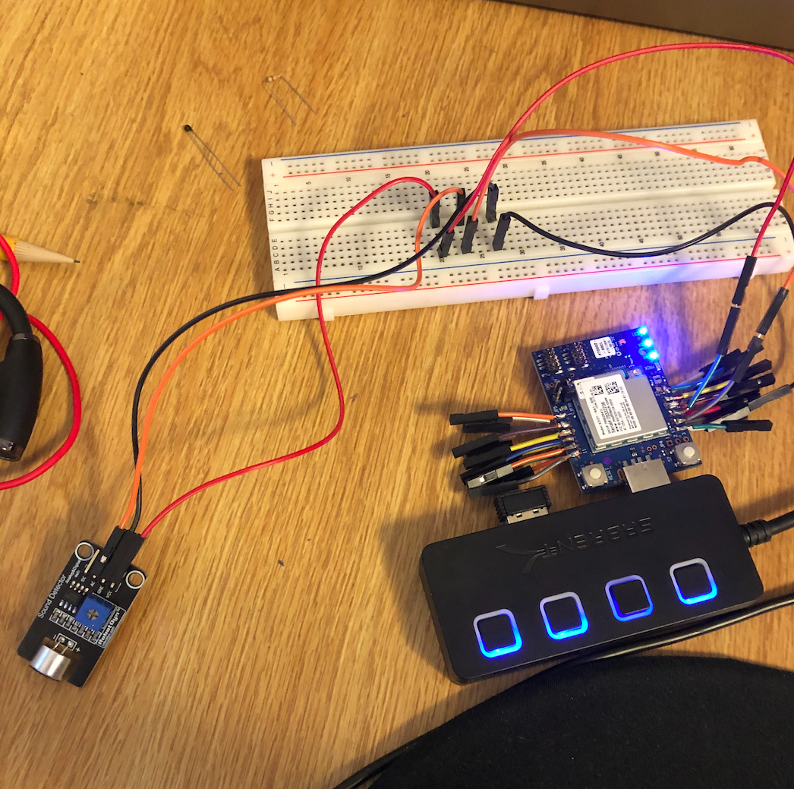
Set up the sound sensor like this:

Slide 15
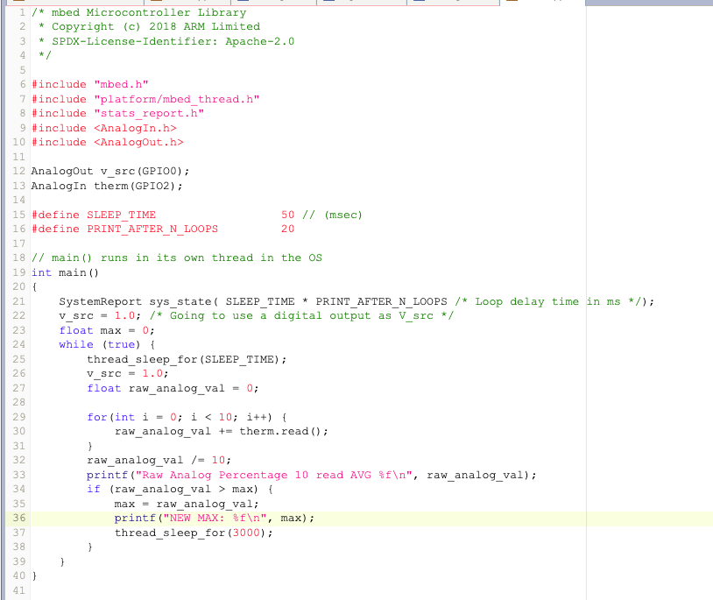
Compile some code very similar to that for the thermistor

Slide 16
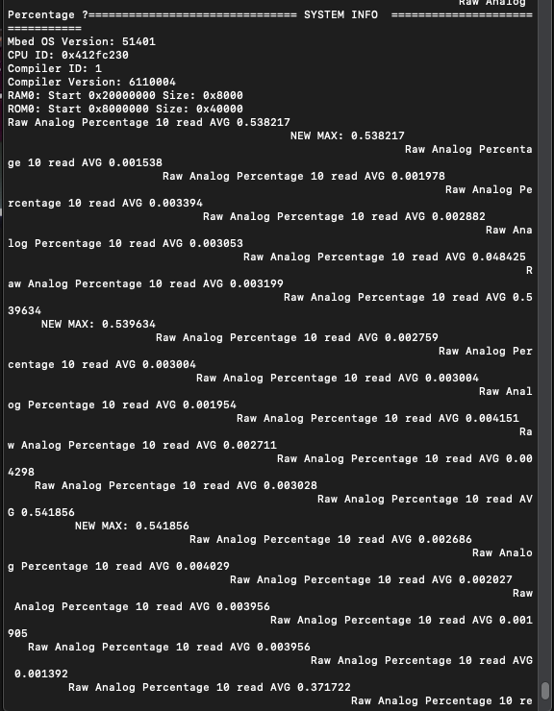
Connect the terminal to the XDOT and hit RESET

